Slide 1
WASTE To WOW
Team 7
Home Waste Management Recommendation System - Recycling or Upcycling

Slide 2
Table of contents.
01 | ResNet50
02 | MobileNetV2
03 | Xception
04 | InceptionResNetV2
05 | YoloV8

Slide 3
ResNet50

Slide 4
Model Proposal
Depth in CNNs: ResNet-50 tackles the vanishing/exploding gradient problem by facilitating the training of much deeper networks.
Innovative Framework: Introduces residual learning which focuses on learning residual functions, significantly different from traditional deep learning approaches.
Residual Building Blocks: Utilizes shortcut connections that perform identity mapping and simplify the learning process, as depicted in the model's architecture figures.
Structured Design: Follows a consistent filter strategy that aligns with the network's depth and complexity, ensuring efficient feature mapping.

Slide 5
Model Proposal
Dimensionality Handling: Employs projection shortcuts for dimension matching in the layers, optimizing the flow of information through the network.
Overcoming Degradation: Effectively addresses the degradation problem, allowing deeper networks to maintain or improve performance over shallower counterparts.

Slide 6
Model Support
Hardware Configuration
Component | Specification
CPU | 9th Gen Intel(R) Core(TM) i5-9300H @ 2.40GHz
GPU | Nvidia GeForce GTX 1650 4 GB
RAM | 16.0 DDR4 GB (15.8 GB usable)
Software Configuration
Component | Specification
OS | Windows 11 Home
IDE | Jupyter Notebook

Slide 7
Tools
Library/Tool | Purpose | Functions/Methods Used
TensorFlow | Primary deep learning framework | keras.applications.ResNet50, keras.layers.GlobalAveragePooling2D, keras.layers.Dense, keras.layers.Dropout, keras.Model, keras.callbacks.EarlyStopping, keras.callbacks.ModelCheckpoint, keras.callbacks.ReduceLROnPlateau
Keras Tuner | For optimizing the hyperparameters of neural networks | RandomSearch
NumPy | Array processing for numbers, strings, records, etc. | np.random.seed
Matplotlib | Plotting library for Python and its numerical extensions | plt.plot, plt.title, plt.ylabel, plt.xlabel, plt.legend, plt.show
Scikit-learn | Machine learning library for Python | classification_report, confusion_matrix

Slide 8
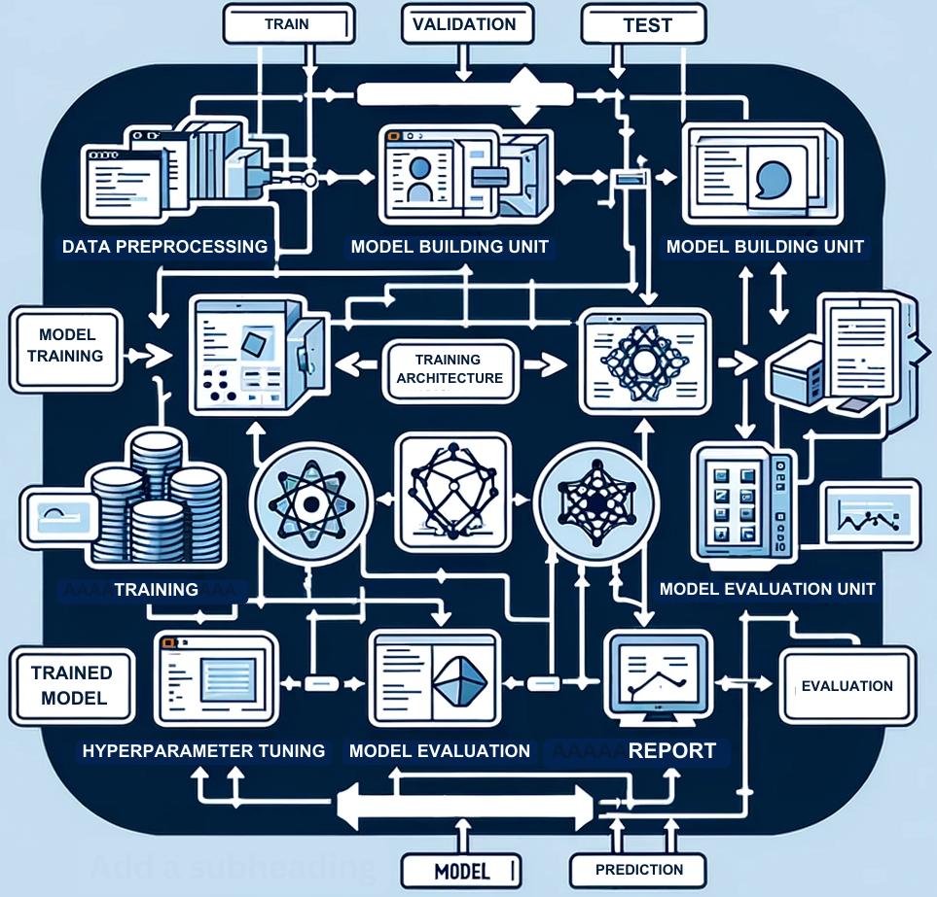
Model Data Flow Diagram
Data Preprocessing: Utilizes TensorFlow's ImageDataGenerator for image resizing, normalization, and augmentation to enhance model generalizability and prevent overfitting.
Model Building: Adopts ResNet50 architecture with custom layers (GlobalAveragePooling2D, Dense, Dropout) for classifying images into 11 classes, implemented within TensorFlow's Model class.
Training and Hyperparameter Tuning: Employs iterative learning with the train_generator object and uses Keras Tuner's RandomSearch for optimizing key hyperparameters like neuron count in Dense layers and learning rate.

Slide 9
Model Data Flow Diagram
Model Evaluation and Reporting: Evaluates performance on unseen datasets, providing metrics (loss, accuracy), and detailed classification reports including precision, recall, f1-scores, and confusion matrices.
Model Prediction and Persistence: Tests generalization on new data and saves the trained model for future use without the need for retraining, ensuring practical deployment readiness.

Slide 10
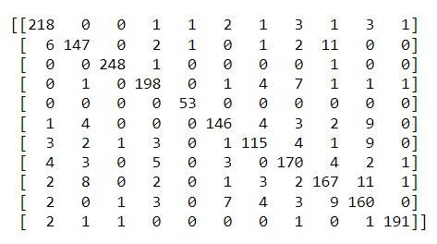
Model Evaluation Results
Biowaste
Cardboard
Clothes
Ewaste
Furniture
Glass
Medical
Metal
Paper
Plastic
Shoes

Slide 11
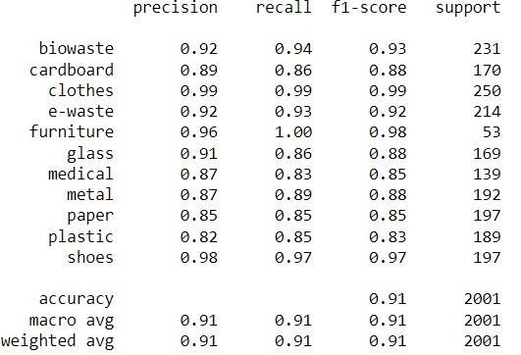
Model Evaluation Results
High Precision and Recall: The model exhibits high precision and recall for most categories, indicating effective learning and accurate predictions.
Exceptional Performance for 'Clothes' and 'Shoes': Achieves the highest precision and recall specifically in the 'clothes' and 'shoes' categories, showcasing the model's strong ability to differentiate these items.
Lower Performance for 'Plastic': Exhibits lower precision and recall in the 'plastic' category, suggesting a need for additional training data or a reevaluation of its feature representations.
Overall Robustness: Maintains an overall accuracy of 0.91 and a weighted average f1-score of 0.91, demonstrating strong and consistent performance across various classes.

Slide 12
MobileNetV2

Slide 13
Model Proposal
MobileNetV2 is a neural network architecture optimized for mobile and embedded devices, balancing efficiency and accuracy.
Innovations include the inverted residual with a linear bottleneck for processing compressed representations effectively.
It builds on prior architectures by incorporating depthwise separable convolutions, linear bottlenecks, and inverted residuals, following advances in deep learning optimization techniques.
Depthwise separable convolutions reduce computational costs by 8 to 9 times compared to standard convolutions.
Linear bottlenecks capture low-dimensional manifolds in neural network activations, maintaining information integrity while reducing dimensionality.

Slide 14
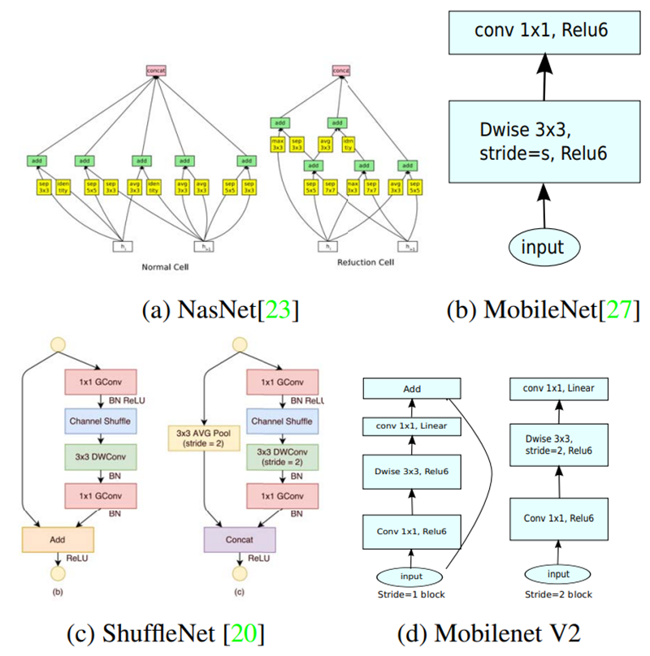
Model Proposal
Inverted residual structures connect shortcuts between bottlenecks, improving gradient flow and memory efficiency.
The architecture consists of an initial convolution layer followed by 19 residual bottleneck layers, with scalability to adjust to various performance needs by modifying width multipliers and input resolution.
MobileNetV2 minimizes memory access during inference, which is advantageous for devices with limited memory.
The model has been proven effective across various applications, including image classification, object detection, and semantic segmentation, showing high accuracy with fewer parameters and reduced computational complexity.

Slide 15
Model Support
Hardware Configuration
Component | Specification
CPU | 11th Gen Intel(R) Core(TM) i5-1155G7 @ 2.50GHz 2.50 GHz
GPU | Intel(R) Iris(R) Xe Graphics
RAM | 16.0 GB (15.8 GB usable)
Software Configuration
Component | Specification
OS | Edition - Windows 11 Home Version - 22H2
IDE | PyCharm 2023.2.4

Slide 16
Tools
Library/Tool | Purpose | Functions/Methods Used
TensorFlow | Primary deep learning framework | Keras API, ImageDataGenerator, MobileNetV2, GlobalAveragePooling2D, Dense, Dropout, Model, EarlyStopping, ModelCheckpoint, ReduceLROnPlateau
Keras Tuner | For optimizing the hyperparameters of neural networks | RandomSearch
NumPy | Array processing for numbers, strings, records, etc. | Random seed setting
Matplotlib | Plotting library for Python and its numerical extensions | Plotting training & validation accuracy and loss
Scikit-learn | Machine learning library for Python | classification_report, confusion_matrix

Slide 17
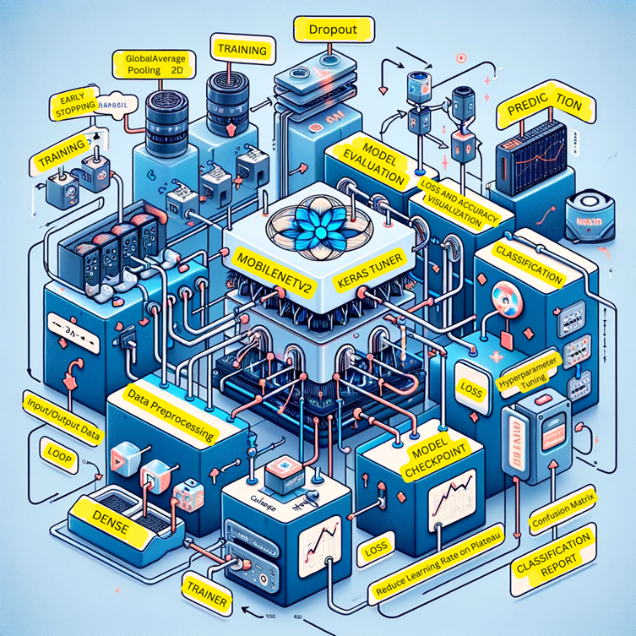
Model Data Flow Diagram
MobileNetV2 is the central architecture, chosen for its balance of efficiency and accuracy, using depthwise separable convolutions.
Post-convolutional layers, the workflow includes a GlobalAveragePooling2D layer for dimensionality reduction and Dropout for regularization.
Dense layers follow for the final classification computation, based on extracted features.
Keras Tuner conducts hyperparameter optimization to find the best model parameters.
Callbacks like EarlyStopping, ModelCheckpoint, and ReduceLROnPlateau regulate the training process to prevent overfitting and optimize learning.
After training, model evaluation is performed using the test set to compute loss and accuracy.

Slide 18
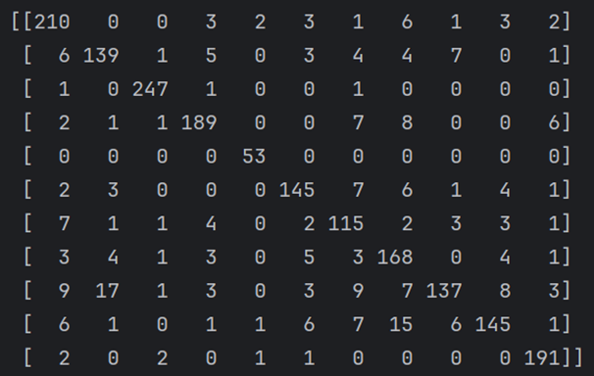
Model Evaluation Results
Biowaste
Cardboard
Clothes
Ewaste
Furniture
Glass
Medical
Metal
Paper
Plastic
Shoes

Slide 19
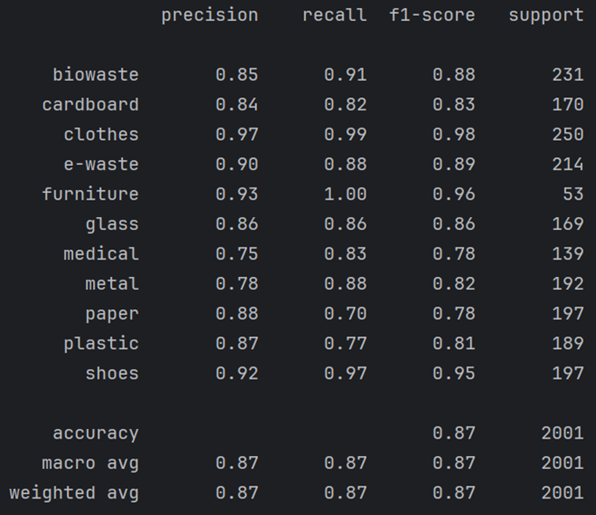
Model Evaluation Results
The model has an overall accuracy of 87%, correctly predicting class labels most of the time.
Both macro and weighted averages for precision, recall, and F1-score are provided, reflecting consistent performance across all classes.
Despite the challenges in classifying numerous waste material types, the model demonstrates robust performance.
There is potential for improvement, suggesting that a different model architecture could yield better results.

Slide 20
Xception

Slide 21
Model Proposal
Xception is a state-of-the-art neural network architecture designed to excel in capturing intricate hierarchical features in images.
Its unique approach involves entirely decoupling cross-channels and spatial correlations in feature maps, a hypothesis that goes beyond the inception module.
Named "Extreme Inception," Xception represents a significant advancement in deep learning architectures.
Hierarchical Feature Extraction: Each layer in the hierarchy focuses on different levels of abstraction, allowing the model to learn representations ranging from simple to complex features.
Depthwise Separable Convolutions: Instead of using traditional convolutions, Xception employs depth wise separable convolutions. A depthwise separable convolution consists of two steps: depthwise convolutions and pointwise convolutions.

Slide 22
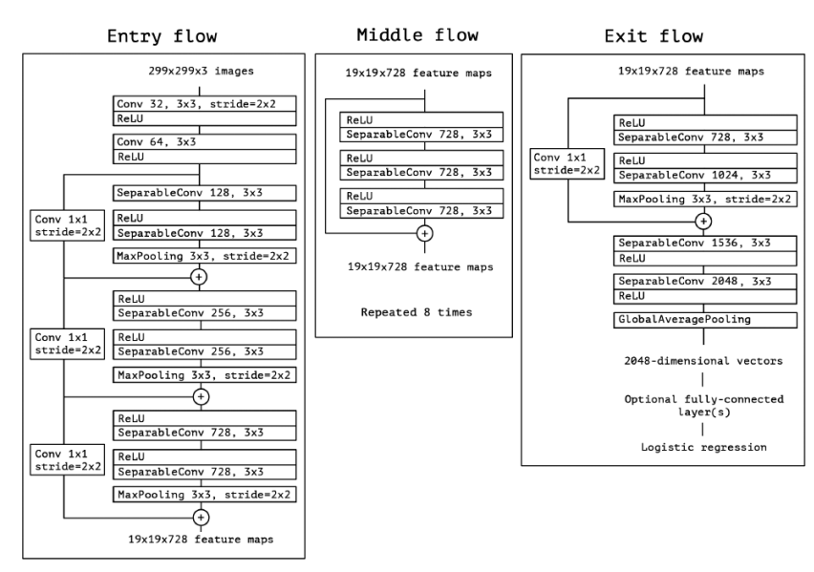
Model Architecture

Slide 23
Model Support
Hardware Configuration
Component | Specification
CPU | 11th Gen Intel(R) Core(TM)
GPU | Intel(R) UHD Graphics 620
RAM | 16.0 GB
Software Configuration
Component | Specification
OS | Windows 11
IDE | Google Colab

Slide 24
Tools
Library/Tool | Purpose | Functions/Methods Used
TensorFlow | Primary deep learning framework | Keras AP, Xception, GlobalAveragePooling2D, Dense
Matplotlib | Plotting library for Python and its numerical extensions | Plotting training & validation accuracy and loss
Scikit-learn | Machine learning library for Python | classification_report

Slide 25
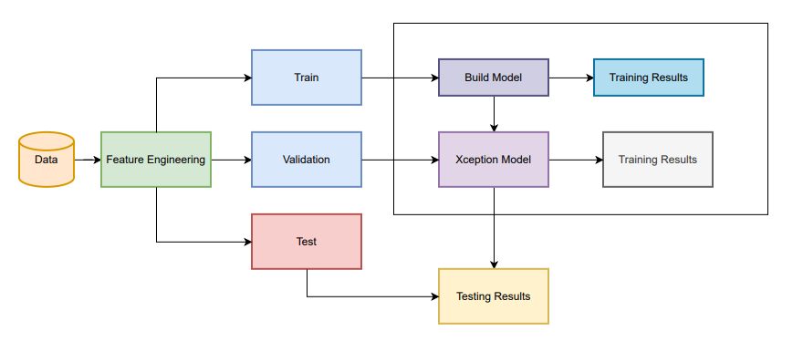
Model Data Flow Diagram
Data Preprocessing: Utilizes TensorFlow's ImageDataGenerator for image resizing, normalization, and augmentation to enhance model generalizability and prevent overfitting.
Train, Validation, and Test: The training data is used to train the model, validation data is used to tune the parameters
Xception Model: A type of deep neural network model that is particularly good at tasks like image recognition.
Training Results: After the model is built, it is trained using the training data, and the results or performance metrics of this training process are recorded.
Testing Results: Finally, the trained Xception model is tested using the test data to evaluate its performance, and the results of this test are noted.

Slide 26
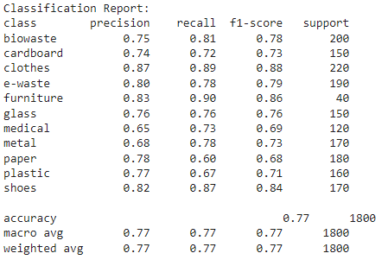
Model Evaluation Results
High Precision and Recall: The model exhibits high precision and recall for clothes and furniture.
Lower Performance for ‘Medical: Exhibits lower precision and recall in the ‘medical’ category
Overall Robustness: Maintains an overall accuracy of 0.77 and a weighted average f1-score of 0.77, demonstrating strong and consistent performance across various classes.

Slide 27
InceptionResNetv2

Slide 28
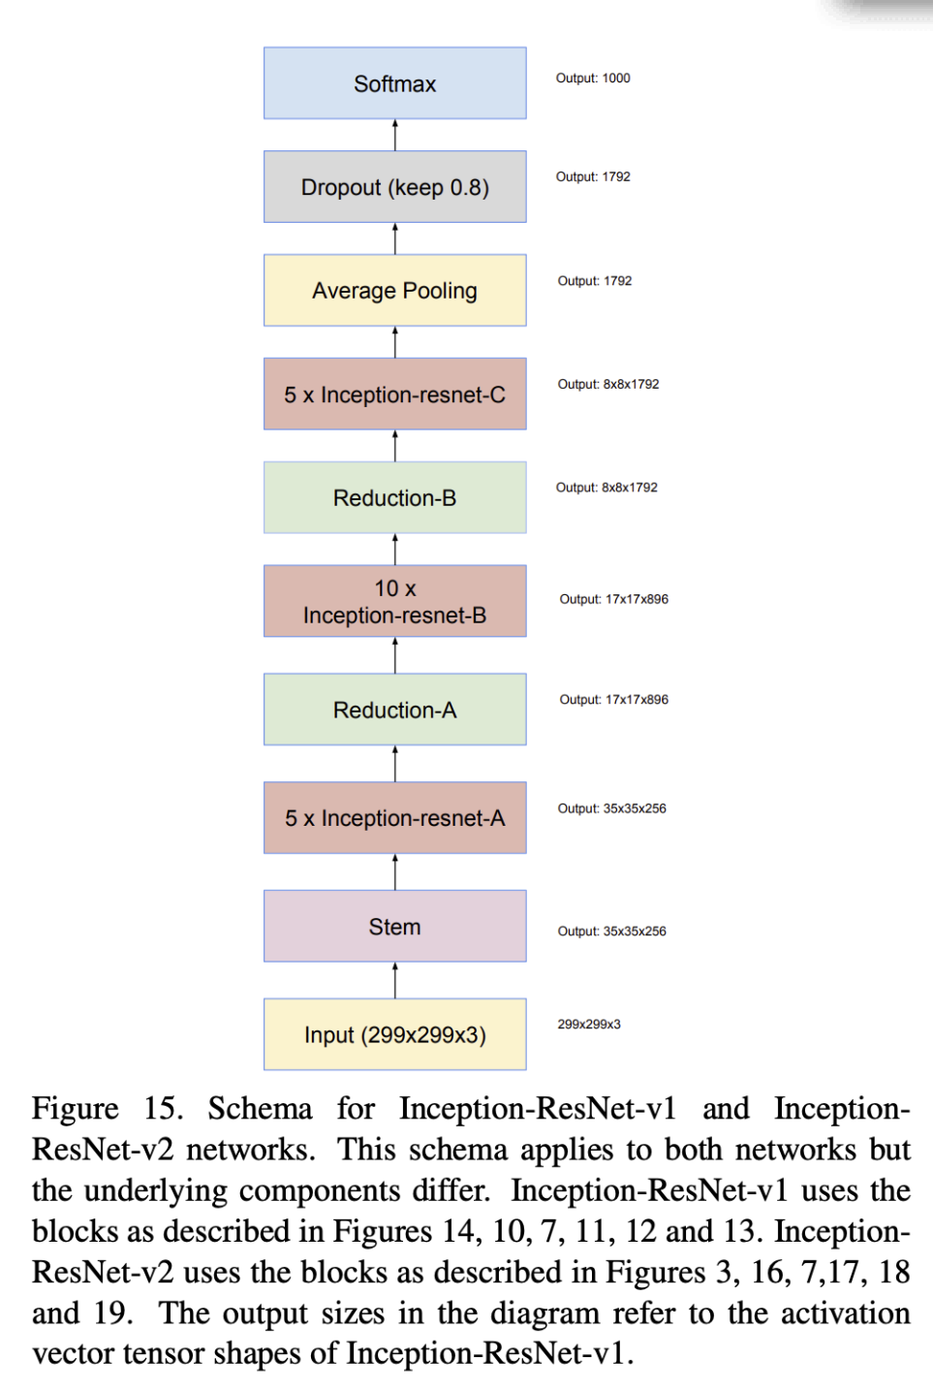
Model Proposal
Deep convolutional neural network (CNN) architecture that combines elements from the Inception and ResNet architectures with 164 layers.
Introduced by Google researchers
Residual Connections: The incorporation of residual connections allows for the training of very deep networks by addressing the vanishing gradient problem.
Inception Modules: InceptionResNetV2 includes Inception modules, which consist of multiple convolutional pathways with different kernel sizes.

Slide 29
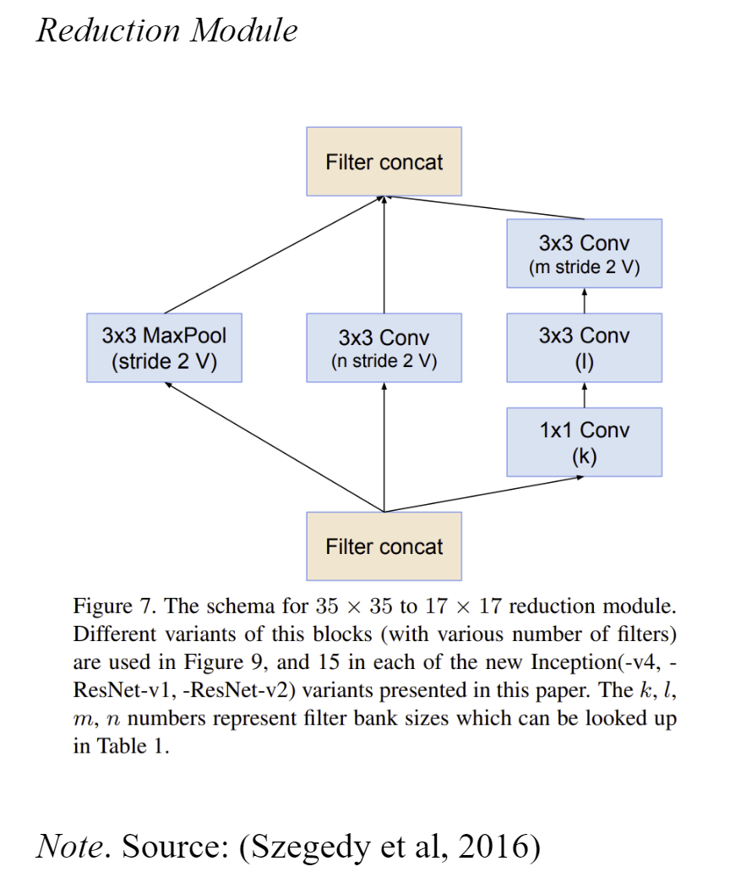
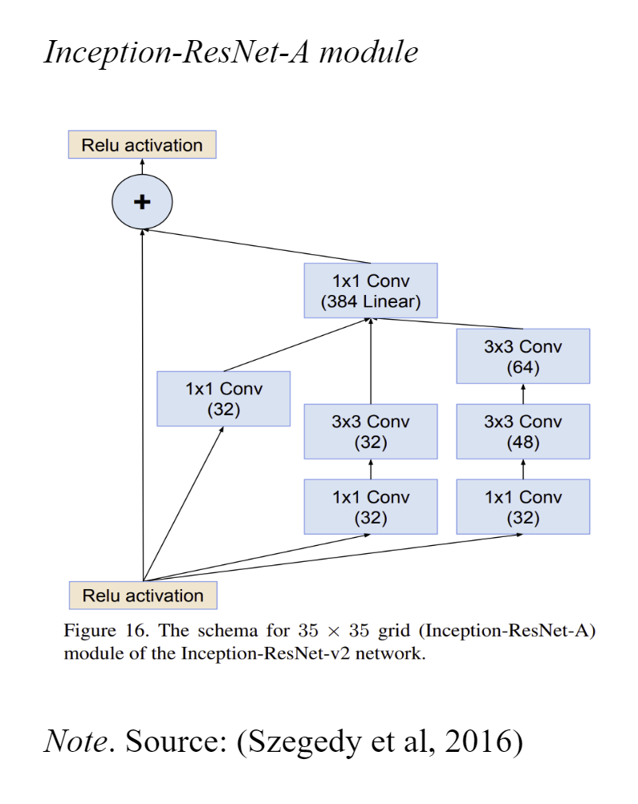
Model Proposal
The number of parameters in InceptionResNetV2 is around 55 million.
The architecture consists of several units such as Inception modules, Residual Connections, Residual Blocks, Auxiliary Classifiers.
Inception modules capture and process information from different spatial resolutions whereas reduction blocks use a combination of convolution and max-pooling to reduce spatial dimensions while increasing the number of filters which helps in plummeting computational complexity.

Slide 30
Model Support
Hardware Configuration
Component | Specification
CPU | 11th Generation Intel® CoreTM – i9-11950H Processor with vProTM (2.60 GHz, up to 5.00 GHz with Turbo Boost, 8 Cores, 16 Threads, 24 MB Cache)
GPU | NVIDIA® GeForce RTXTM 3080 with Max-Q 16GB
RAM | 64 GB DDR4 3200MHz (2x32 GB)
Storage | 1 TB Ple SSD Gen4
Software Configuration
Component | Specification
OS | Windows 10 Pro 64
IDE | PyCharm 2022.2.2 (Edu)
Google Collaboratory Notebook Python | 3.10.12

Slide 31
Tools
Library/Tool | Method | Usage
TensorFlow | Keras API, ImageDataGenerator, InceptionResNetV2, GlobalAveragePooling2D, Dense, Dropout, Model, EarlyStopping,ModelCheckpoint, ReduceLROnPlateau | For building InceptionResNetv2 architecture
Keras Tuner | RandomSearch | For Hyperparameter tuning
sklearn.metrics | classification_report, confusion_matrix | For plotting classification report and confusion matrix
Matplotlib.pyplot | plot | For plotting training and validation accuracies and losses
Numpy | Random_seed | For reproducibility

Slide 32
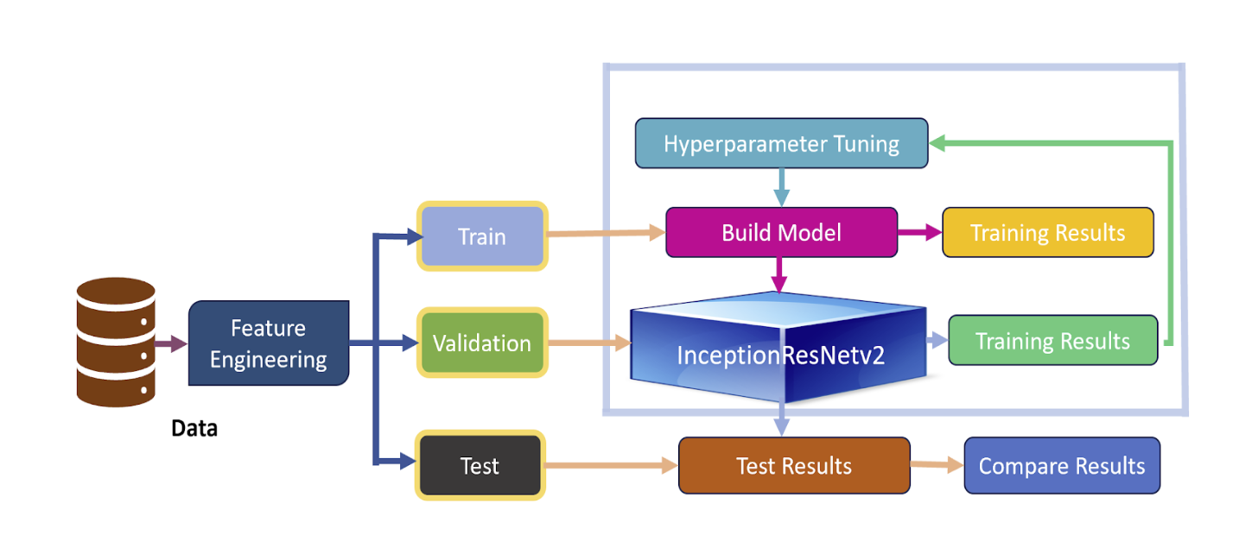
Model Data Flow Diagram
ImageDataGenerator by the Keras library is used for real-time data augmentation during model training. It generates batches of augmented image data in real-time while the model is still being trained.
Data generators feed batches of data to the model during training, allowing for a continuous flow of data without loading the entire dataset at once.
RandomSearch from Keras tuner is used to perform hyperparameter tuning that samples sets from the hyperparametric search space.

Slide 33
Model Data Flow Diagram
Global Average Pooling is applied to reduce the spatial dimensions of the feature maps and obtain a global representation. It helps in reducing the number of parameters in the model.
Dropout Layer is used for regularization
A dense hidden layer is added with varying hyperparametric searchable units.
Output layer is an 11 class node with a softmax function.
Callbacks such as EarlyStopping to stop training when a monitored metric has stopped improving, ModelCheckPoint to save the model's weights during training, and ReduceLROnPlateau to reduce the learning rate when a monitored metric has stopped improving is applied. This improves execution efficiency.
Model is evaluated and accuracy and loss are extracted. Their respective plots are generated.
Confusion Matrix and Classification reports are generated to analyze the results.

Slide 34
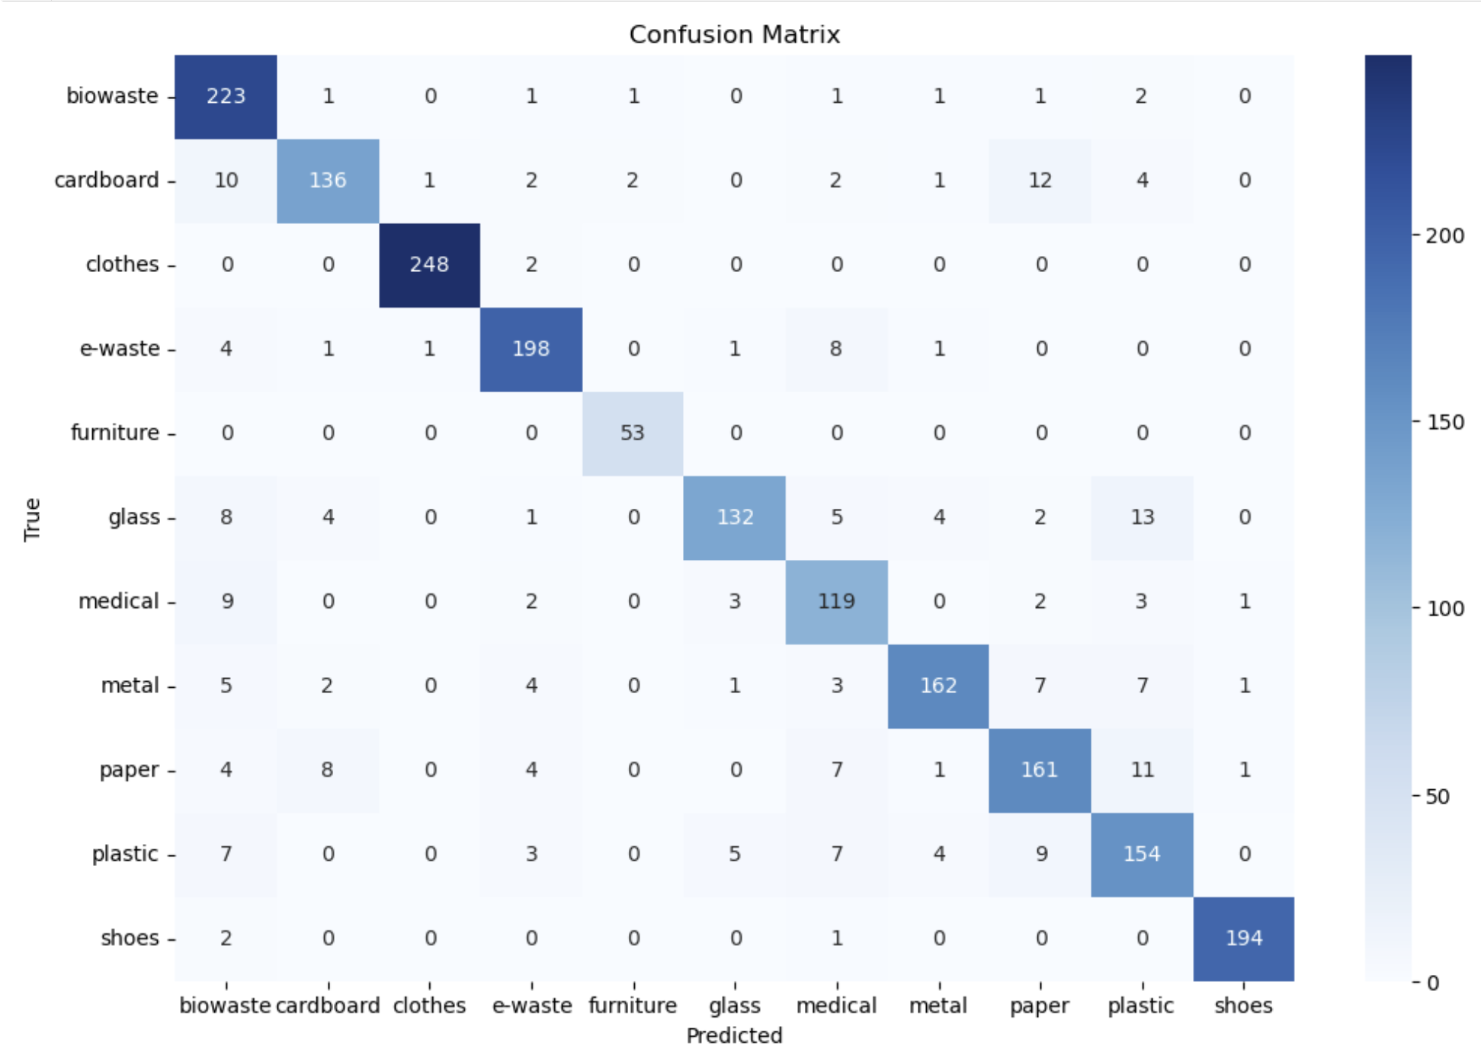
Model Evaluation Results

Slide 35
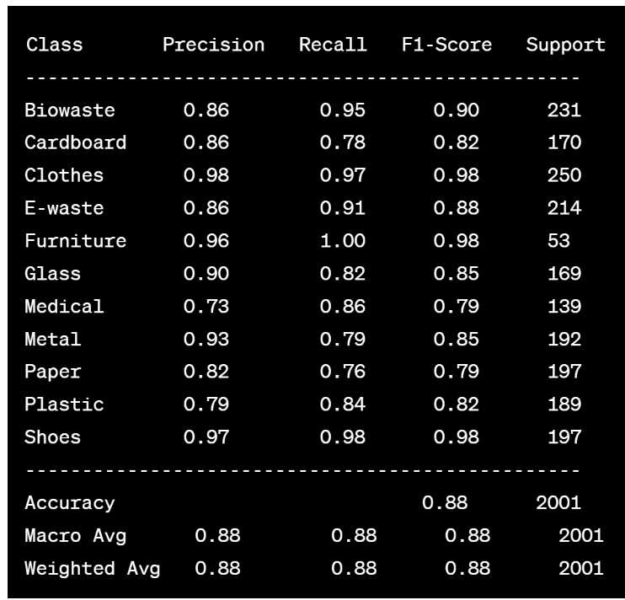
Model Evaluation Results
The harmonic mean of Precision and Recall, F1-score performs the best for Furniture, Clothes, and Shoes.
Macro average and Weighted average for all Precision, Recall, and F1-score are 88% showing consistent performance across all classes.
The model can further be enhanced.

Slide 36
YoloV8

Slide 37
Model Proposal
YOLOv8 is a state of the art object detection model.
It has recently included classification capabilities
The model is pretrained on ImageNet dataset which is similar to all the other models of our research.
As a one-stage detector, YOLO completes both object recognition and classification in a single network run
Basic architecture is made up of Backbone, Neck, and Head Layers
Backbone: Extracts high-level features from the input image.
Neck: Refines and merges features obtained from the backbone.
Produces bounding box predictions and class probabilities.

Slide 38
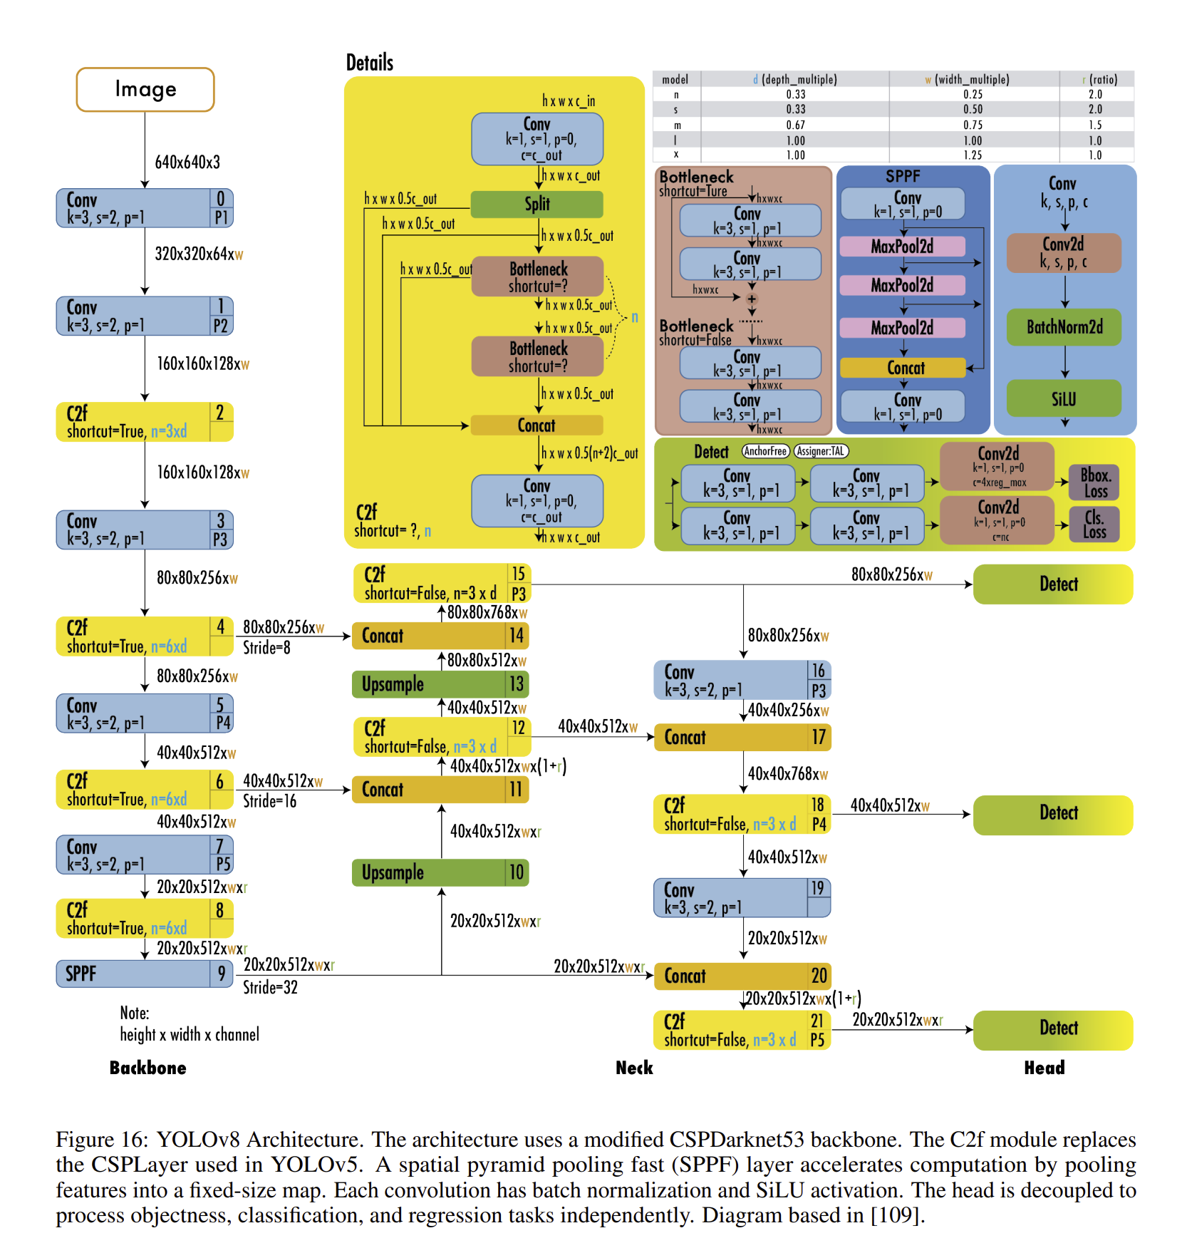
Model Proposal

Slide 39
Model Support
Hardware Configuration
Component | Specification
CPU | Intel® Xeon® CPU @ 2.00Ghz
GPU | A100 SXM4
RAM | 40 GB
Storage | 54 GB
Software Configuration
Component | Specification
OS | Windows 10 Pro 64
IDE | PyCharm 2022.2.2 (Edu)
Google Collaboratory Notebook Python | 3.10.12

Slide 40
Tools
Library/Tool | Package | Method | Usage
Google colab | os drive | Getcwd, chdir, path.join mount | Get and change directories, navigating through different paths To mount drive
Ultralytics | YOLO Glob IPython.display Numpy | Train, val, and predict, task = classify, detect glob Image Random_seed | Training ,validation, and predictions for classification and detection For carrying list of all image paths To view image from a path with specific size. For reproducability
tensorboard |  | logdir | For monitoring training performance

Slide 41
Tools
Library/Tool | Method | Usage
TensorFlow | keras.applications.ResNet50, keras.layers.GlobalAveragePooling2D, keras.layers.Dense, keras.layers.Dropout, keras.Model, keras.callbacks.EarlyStopping, keras.callbacks.ModelCheckpoint, keras.callbacks.ReduceLROnPlateau | Primary deep learning framework
Keras Tuner | RandomSearch | For optimizing the hyperparameters of neural networks
Numpy | Random_seed | Array processing for numbers, strings, records, etc.

Slide 42
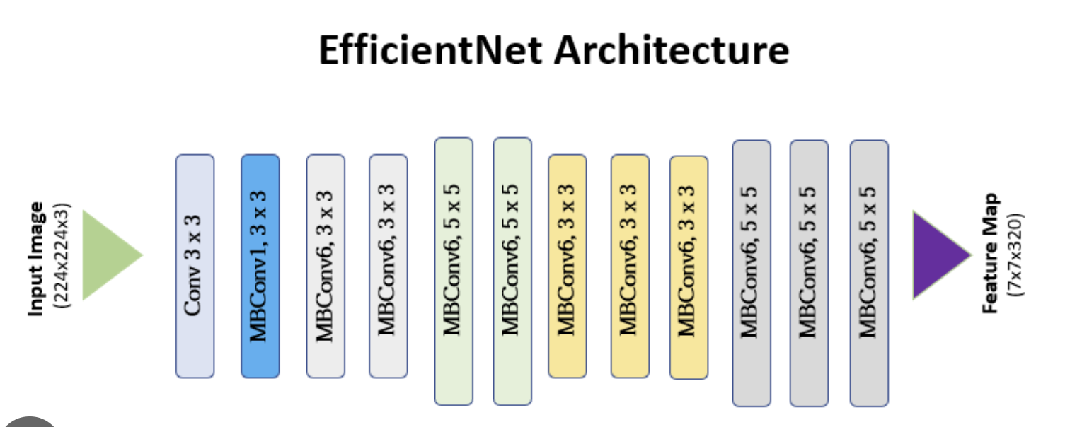
Model Data Flow Diagram
It does classification using a version of the EfficientNet architecture for classification.
The key idea is to balance the model size with accuracy.
It comes in five flavors - nano, small, medium, large , extra large
All the parameters can be configured using a yaml file.
The model takes in task as classification or detection and mode to be train, val for validation and predict for inference.

Slide 43
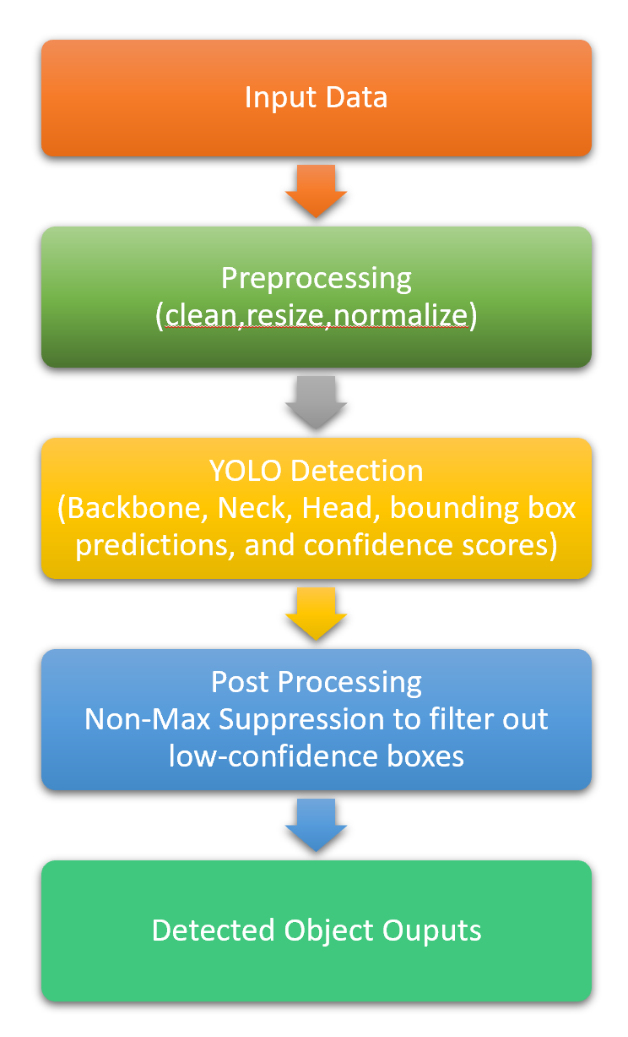
Model Data Flow Diagram
YOLO’s Object Detection is trained on COCO dataset that has 90 categories.
It is very efficient and predicts bounding box and confidence scores for target class.
mAP, Precision, Recall, F1-curve are calculated to evaluate the performance.

Slide 44
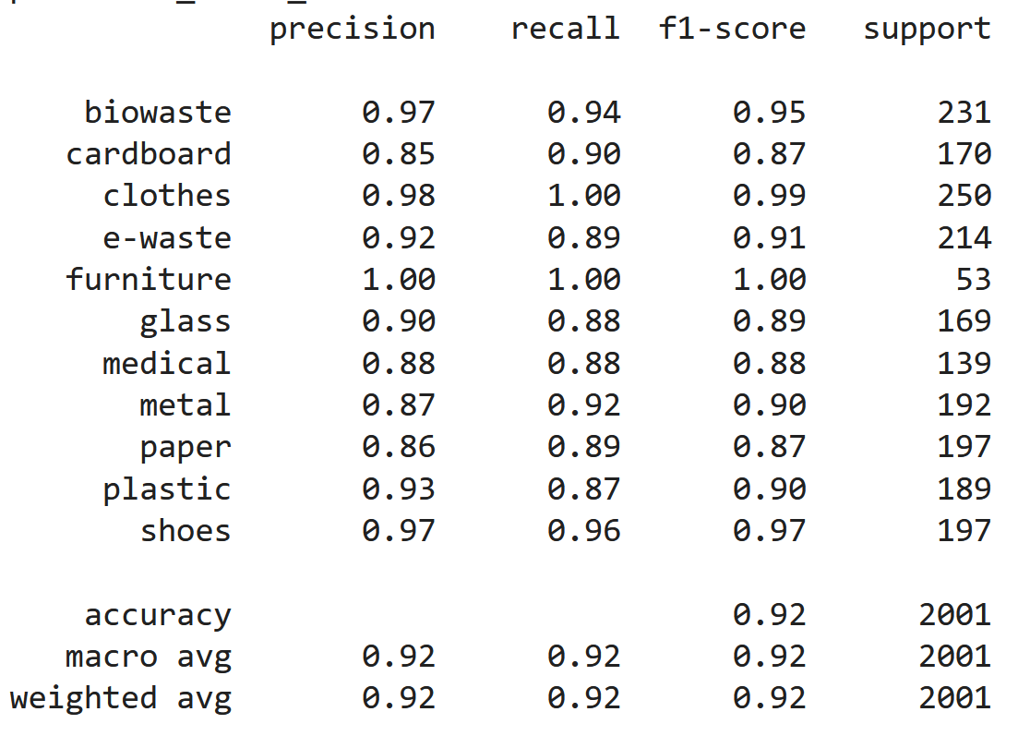
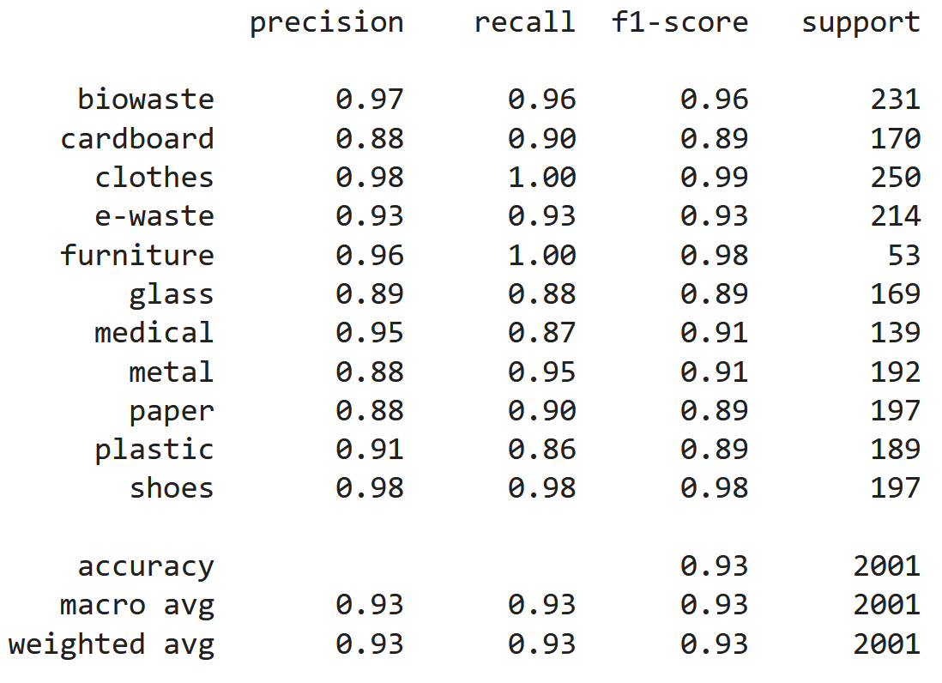
Model Data - Classification
YOLOv8 - Nano
YOLOv8 - Small

Slide 45
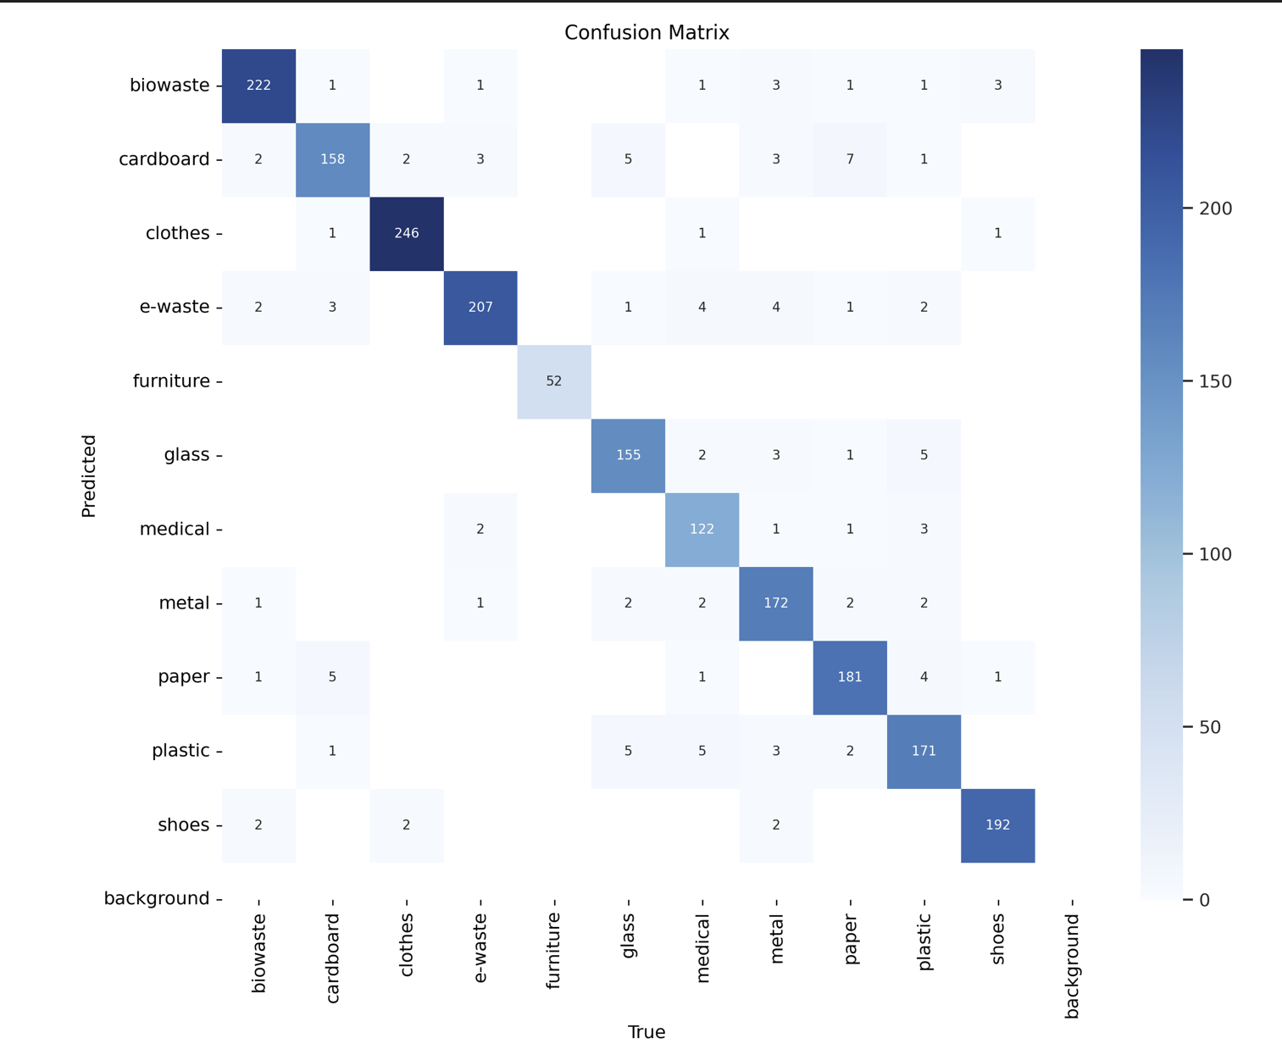
YOLO Evaluation Results - Classification
YOLOv8 - small

Slide 46
YOLO Evaluation Results - Classification
YOLOv8-n nano model took 5.5 hours to train on 100 epochs
YOLOv8-s small took 7.3 hours to train on 100 epochs
YOLOv8-s small performed the best with highest accuracy of 94%
Model | Top1 | Top5 | Inference Speed
YOLOv8-n | 93.1% | 99.6% | 0.6
YOLOv8-s | 94% | 99.6% | 1.0

Slide 47
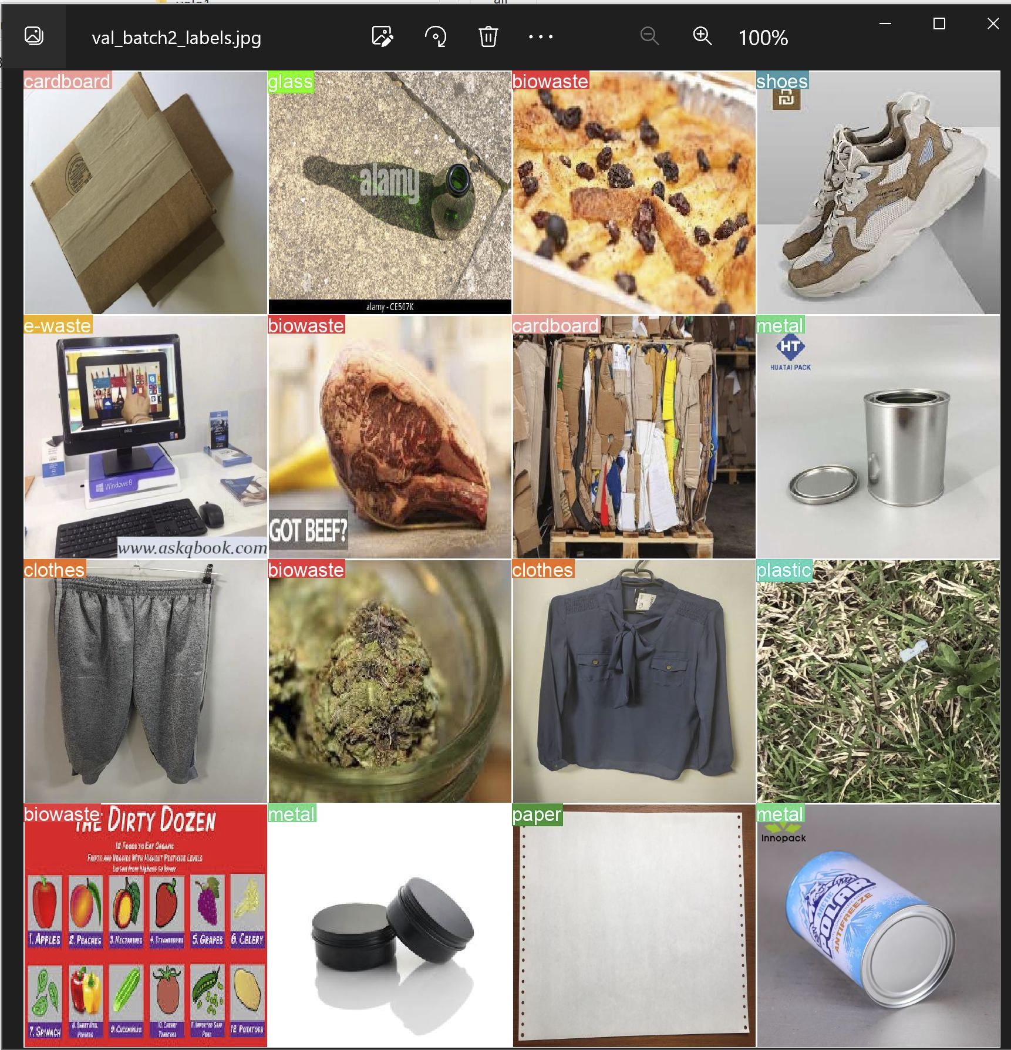
YOLO Evaluation Results - Classification

Slide 48
YOLOv8 Different Versions Model Comparison - Object Detection
Initially YOLOv8 medium(295 layers) model trained for 25 epochs on 1100 images annotated with CVAT tool
Training took 0.055 hours
Annotated images through Grounding DIno, more than 1100 images per class got detected.
Trained on YOLOv8-medium again for 100 epochs.. e-waste category performed really badly.
After working on the dataset again re-trained the model on YOLOv8’s large variant for 400 epochs.
The model performed consistently across all the thresholds.
Model | mAP50 | mAP 50-95 | Inference Time (ms)
YOLOv8-m (1100 images) | 0.579 | 0.409 | 0.6
YOLOv8-m | 0.745 | 0.699 | 1.7
YOLOv8-l | 0.863 | 0.862 | 4.6

Slide 49
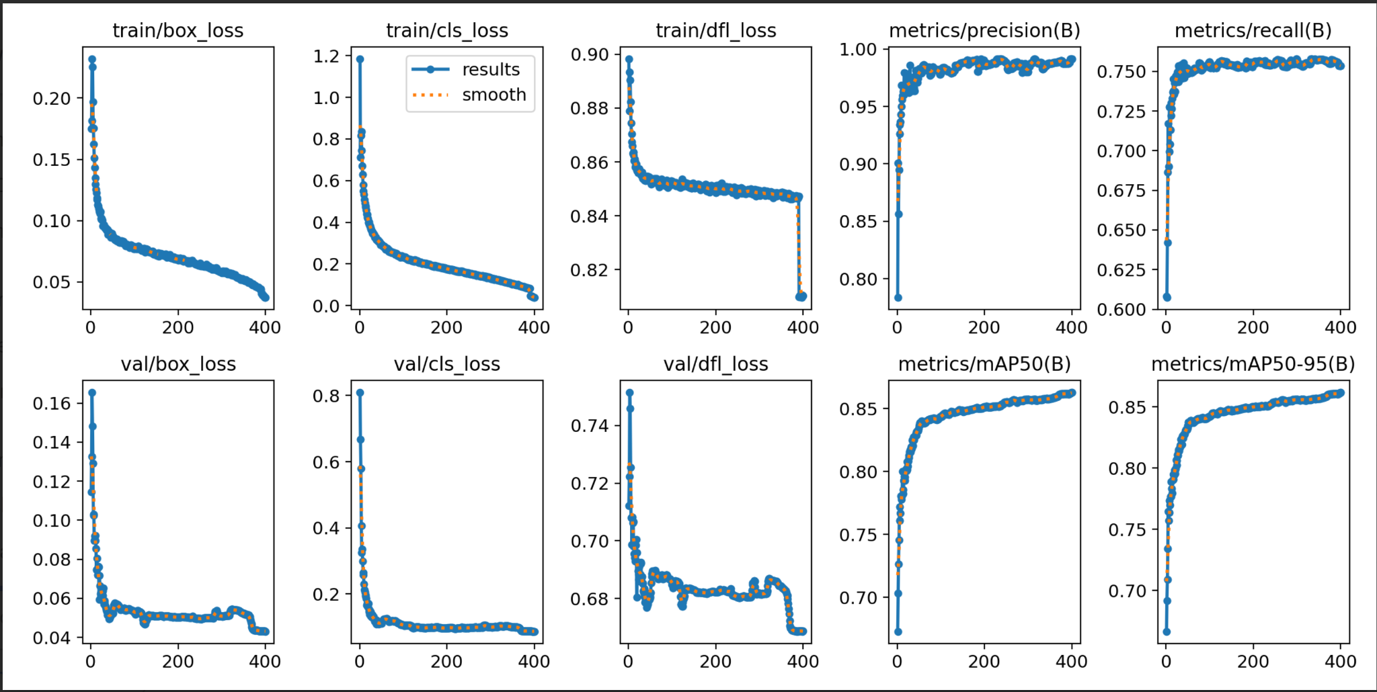
YOLOv8 Object Detection

Slide 50
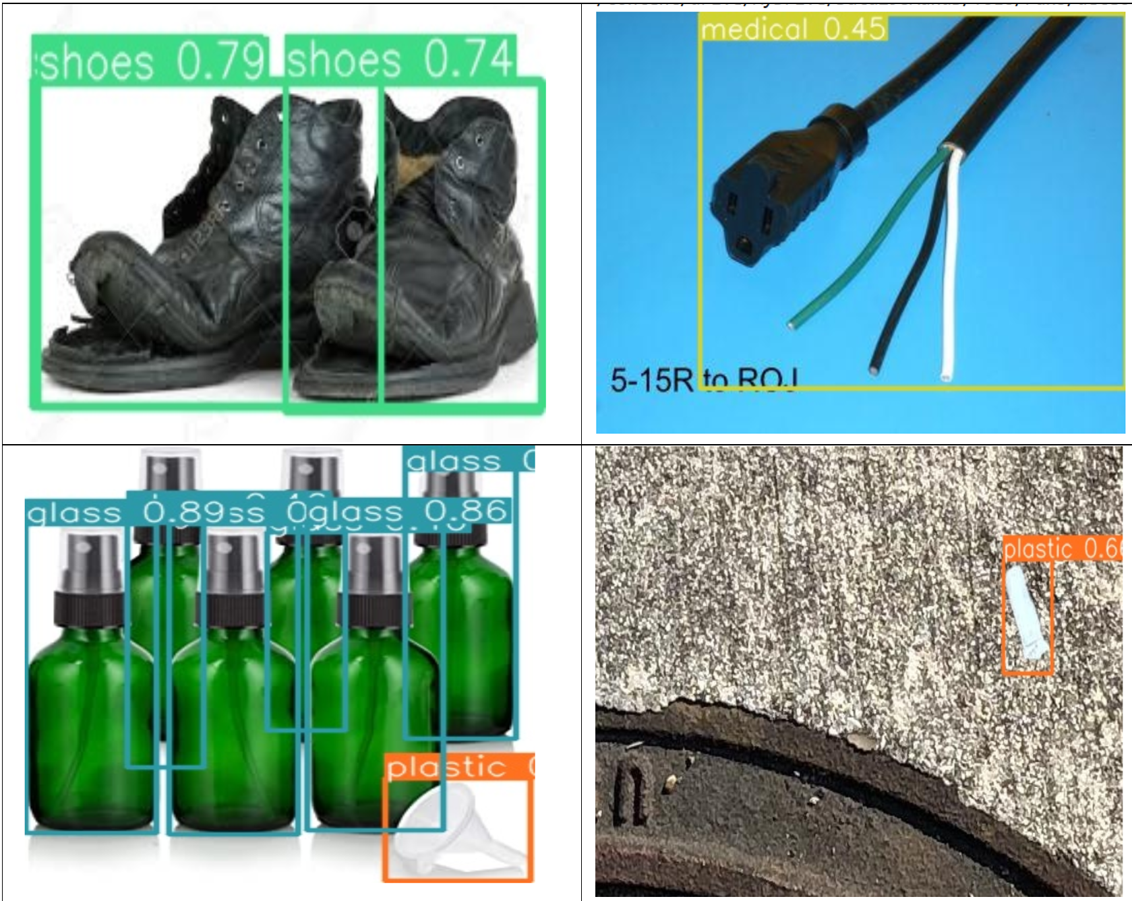
YOLOv8 Object Detection

Slide 51
Model Comparison - Classification
Model | F1-Score
ResNet50 | 0.91
Xception | 0.87
MobileNetv2 | 0.87
InceptionResnetv2 | 0.88
YOLOv8-n | 0.92
YOLO v8-s | 0.93

Slide 52
Thank You!
Do you have any questions?

